Slide 1
Course Details
Course Code : CSE3075
Course Name: Mobile Application Development [MAD] Credit Structure: 3 Credits (L=1, P=4, C=3)
Instructor In-Charge & Instructor: Ms. B Prema Sindhuri & Dr. Blessed Prince

Slide 2
MODULE 3
Topics Covered:
Activities,
Services,
Broadcast receivers,
Content providers.
Course Outcome Achievable:
C.O. 3: Demonstrate the use of services, broadcast receiver, Notifications and content provider.

Slide 3
Services
A Service is an application component that can perform long-running operations in the background. It does not provide a user interface. Once started, a service might continue running for some time, even after the user switches to another application. Additionally, a component can bind to a service to interact with it and even perform interprocess communication (IPC).
For example, a service can handle network transactions, play music, perform file I/O, or interact with a content provider, all from the background.

Slide 4
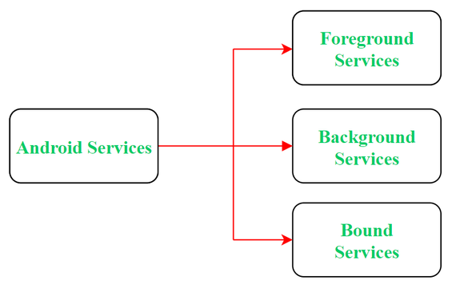
Types of Services
Foreground Services: Services that notify the user
about its ongoing operations are termed as Foreground
Services. Users can interact with the service by the
notifications provided about the ongoing task.
2. Background Services: Background services do not require any user intervention. These services do not notify the user about ongoing background tasks and users also cannot access them.
3. Bound Services: This type of android service allows the components of the application like activity to bound themselves with it. Bound services perform their task as long as any application component is bound to it. In order to bind an application component with a service bindService() method is used.

Slide 5
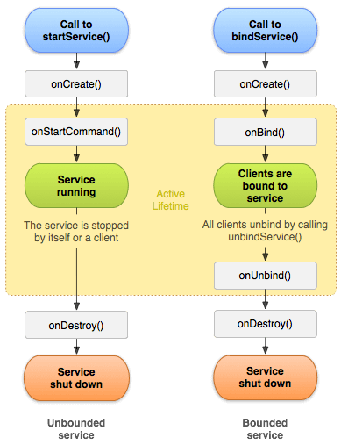
Life Cycle of Android Services
onStartCommand(): The Android service calls this method when a component(eg: activity) requests to start a service using startService(). Once the service is started, it can be stopped explicitly using stopService() or stopSelf() methods.
onCreate(): Whenever a service is created either using onStartCommand() or onBind(), the android system calls this method. This method is necessary to perform a one-time-set-up.

Slide 6
Life Cycle of Android Services
onBind(): This method is mandatory to implement in android service and is invoked whenever an application component calls the bindService() method in order to bind itself with a service. User-interface is also provided to communicate with the service effectively by returning an IBinder object. If the binding of service is not required then the method must return null.
onUnBind(): The Android system invokes this method when all the clients get disconnected from a particular service interface.
onDestroy(): When a service is no longer in use, the system invokes this method just before the service destroys as a final clean up call. Services must implement this method in order to clean up resources like registered listeners, threads, receivers, etc.

Slide 7
Broadcasts
Android apps can send or receive broadcast messages from the Android system and other Android apps, similar to the publish-subscribe design pattern.
These broadcasts are sent when an event of interest occurs. For example, the Android system sends broadcasts when various system events occur, such as when the system boots up or the device starts charging. Apps can also send custom broadcasts, for example, to notify other apps of something that they might be interested in.

Slide 8
Broadcasts
Apps can register to receive specific broadcasts. When a broadcast is sent, the system automatically routes broadcasts to apps that have subscribed to receive that particular type of broadcast.
Generally speaking, broadcasts can be used as a messaging system across apps and outside of the normal user flow. However, you must be careful not to abuse the opportunity to respond to broadcasts and run jobs in the background that can contribute to a slow system performance.

Slide 9
About system broadcasts
The system automatically sends broadcasts when various system events occur, such as when the system switches in and out of airplane mode. System broadcasts are sent to all apps that are subscribed to receive the event.
For a complete list of system broadcast actions, see the BROADCAST_ACTIONS.TXT file in the Android SDK. Each broadcast action has a constant field associated with it. For example, the value of the constant ACTION_AIRPLANE_MODE_CHANGED is android.intent.action.AIRPLANE_MODE. Documentation for each broadcast action is available in its associated constant field.

Slide 10
Changes to system broadcasts
As the Android platform evolves, it periodically changes how system broadcasts behave. Keep the following changes in mind if your app targets Android 7.0 (API level 24) or higher, or if it's installed on devices running Android 7.0 or higher.
Android 9:
Beginning with Android 9 (API level 28), The NETWORK_STATE_CHANGED_ACTION broadcast doesn't receive information about the user's location or personally identifiable data.
Android 8.0:
Beginning with Android 8.0 (API level 26), the system imposes additional restrictions on manifest-declared receivers.
If your app targets Android 8.0 or higher, you cannot use the manifest to declare a receiver for most implicit broadcasts (broadcasts that don't target your app specifically). You can still use a context-registered receiver when the user is actively using your app.

Slide 11
Changes to system broadcasts
Android 7.0
Android 7.0 (API level 24) and higher don't send the following system broadcasts:
ACTION_NEW_PICTURE
ACTION_NEW_VIDEO
Also, apps targeting Android 7.0 and higher must register the CONNECTIVITY_ACTION broadcast using registerReceiver(BroadcastReceiver, IntentFilter). Declaring a receiver in the manifest doesn't work.

Slide 12
Receiving broadcasts
Apps can receive broadcasts in two ways: through manifest-declared receivers and context-registered receivers.
Manifest-declared receivers
If you declare a broadcast receiver in your manifest, the system launches your app (if the app is not already running) when the broadcast is sent.
To declare a broadcast receiver in the manifest, perform the following steps:
Specify the <receiver> element in your app's manifest.
<receiver android:name=".MyBroadcastReceiver" android:exported="true"> <intent-filter> <action android:name="android.intent.action.BOOT_COMPLETED"/> <action android:name="android.intent.action.INPUT_METHOD_CHANGED" /> </intent-filter> </receiver>

Slide 13
Receiving broadcasts
Subclass BroadcastReceiver and implement onReceive(Context, Intent). The broadcast receiver in the following example logs and displays the contents of the broadcast:
public class MyBroadcastReceiver extends BroadcastReceiver { private static final String TAG = "MyBroadcastReceiver"; @Override public void onReceive(Context context, Intent intent) { StringBuilder sb = new StringBuilder(); sb.append("Action: " + intent.getAction() + "\n"); sb.append("URI: " + intent.toUri(Intent.URI_INTENT_SCHEME).toString() + "\n"); String log = sb.toString(); Log.d(TAG, log); Toast.makeText(context, log, Toast.LENGTH_LONG).show(); } }

Slide 14
Receiving broadcasts
Context-registered receivers: To register a receiver with a context, perform the following steps: Create an instance of BroadcastReceiver.
BroadcastReceiver br = new MyBroadcastReceiver();
Create an IntentFilter and register the receiver by calling registerReceiver(BroadcastReceiver, IntentFilter):
IntentFilter filter = new IntentFilter(ConnectivityManager.CONNECTIVITY_ACTION); filter.addAction(Intent.ACTION_AIRPLANE_MODE_CHANGED); this.registerReceiver(br, filter);
Context-registered receivers receive broadcasts as long as their registering context is valid. For an example, if you register within an Activity context, you receive broadcasts as long as the activity is not destroyed. If you register with the Application context, you receive broadcasts as long as the app is running.
To stop receiving broadcasts, call unregisterReceiver(android.content.BroadcastReceiver). Be sure to unregister the receiver when you no longer need it or the context is no longer valid.

Slide 15
Sending broadcasts
Android provides three ways for apps to send broadcast:
The sendOrderedBroadcast(Intent, String) method sends broadcasts to one receiver at a time. As each receiver executes in turn, it can propagate a result to the next receiver, or it can completely abort the broadcast so that it won't be passed to other receivers. The order receivers run in can be controlled with the android:priority attribute of the matching intent-filter; receivers with the same priority will be run in an arbitrary order.
The sendBroadcast(Intent) method sends broadcasts to all receivers in an undefined order. This is called a Normal Broadcast. This is more efficient, but means that receivers cannot read results from other receivers, propagate data received from the broadcast, or abort the broadcast.
The LocalBroadcastManager.sendBroadcast method sends broadcasts to receivers that are in the same app as the sender. If you don't need to send broadcasts across apps, use local broadcasts. The implementation is much more efficient (no interprocess communication needed) and you don't need to worry about any security issues related to other apps being able to receive or send your broadcasts.

Slide 16
The sendBroadcast(Intent) method sends broadcasts to all receivers in an undefined order. This is called a Normal Broadcast. This is more efficient, but means that receivers cannot read results from other receivers, propagate data received from the broadcast, or abort the broadcast.
The LocalBroadcastManager.sendBroadcast method sends broadcasts to receivers that are in the same app as the sender. If you don't need to send broadcasts across apps, use local broadcasts. The implementation is much more efficient (no interprocess communication needed) and you don't need to worry about any security issues related to other apps being able to receive or send your broadcasts.

Slide 17
Delivering a broadcast Cont…
A broadcast is a message that any app can receive.
The system delivers various broadcasts for system events, such as when the system boots up or the device starts charging.
You can deliver a broadcast to other apps by passing an Intent to sendBroadcast() or sendOrderedBroadcast().

Slide 18
Content Provider
In Android, Content Providers are a very important component that serves the purpose of a relational database to store the data of applications. The role of the content provider in the android system is like a central repository in which data of the applications are stored, and it facilitates other applications to securely access and modifies that data based on the user requirements.
Android system allows the content provider to store the application data in several ways. Users can manage to store the application data like images, audio, videos, and personal contact information by storing them in SQLite Database, in files, or even on a network.
In order to share the data, content providers have certain permissions that are used to grant or restrict the rights to other applications to interfere with the data.

Slide 19
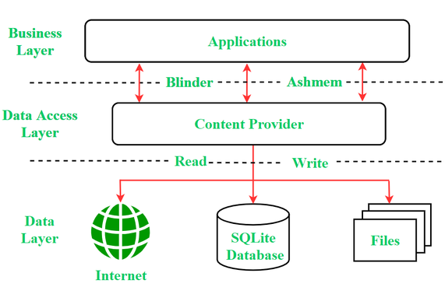
Content Provider

Slide 20
Content Provider
Content URI
Content URI(Uniform Resource Identifier) is the key concept of Content providers. To access the data from a content provider, URI is used as a query string.
Structure of a Content URI:
content://authority/optionalPath/optionalID

Slide 21
Content Provider
Details of different parts of Content URI:
content:// – Mandatory part of the URI as it represents that the given URI is a Content URI.
authority – Signifies the name of the content provider like contacts, browser, etc. This part must be unique for every content provider.
optionalPath – Specifies the type of data provided by the content provider. It is essential as this part helps content providers to support different types of data that are not related to each other like audio and video files.
optionalID – It is a numeric value that is used when there is a need to access a particular record.

Slide 22
Content Provider
Operations in Content Provider
Four fundamental operations are possible in Content Provider namely Create, Read, Update, and Delete. These operations are often termed as CRUD operations.
Create: Operation to create data in a content provider.
Read: Used to fetch data from a content provider.
Update: To modify existing data.
Delete: To remove existing data from the storage.

Slide 23
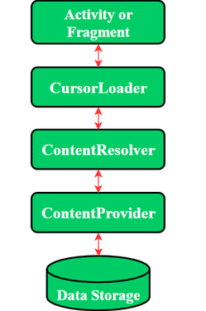
Content Provider
Working of the Content Provider
UI components of android applications like Activity and Fragments use an object CursorLoader to send query requests to ContentResolver. The ContentResolver object sends requests (like create, read, update, and delete) to the ContentProvider as a client. After receiving a request, ContentProvider process it and returns the desired result. Below is a diagram to represent these processes in pictorial form.

Slide 24
Content Provider
Creating a Content Provider
Following are the steps which are essential to follow in order to create a Content Provider:
Create a class in the same directory where the that MainActivity file resides and this class must extend the ContentProvider base class.
To access the content, define a content provider URI address.
Create a database to store the application data.
Implement the six abstract methods of ContentProvider class.
Register the content provider in AndroidManifest.xml file using <provider> tag.

Slide 25
Content Provider
Abstract Methods of a Content Provider:
query(): A method that accepts arguments and fetches the data from the desired table. Data is retired as a cursor object.
insert(): To insert a new row in the database of the content provider. It returns the content URI of the inserted row.
update(): This method is used to update the fields of an existing row. It returns the number of rows updated.
delete(): This method is used to delete the existing rows. It returns the number of rows deleted.
getType(): This method returns the Multipurpose Internet Mail Extension(MIME) type of data to the given Content URI.
onCreate(): As the content provider is created, the android system calls this method immediately to initialise the provider.

Slide 26
END OF MODULE 3

Slide 27
Learn more …
https://developer.android.com/guide/components/activities/intro-activities
https://www.geeksforgeeks.org/different-types-of-activities-in-android-studio/
https://developer.android.com/guide/components/services
https://www.geeksforgeeks.org/services-in-android-with-example/
https://developer.android.com/guide/components/broadcasts
https://www.geeksforgeeks.org/broadcast-receiver-in-android-with-example/
https://developer.android.com/guide/topics/providers/content-provider-basics
https://developer.android.com/reference/android/content/ContentProvider#:~:text=Content%20providers%20are%20one%20of,share%20data%20between%20multiple%20applications.

Slide 28
Thank You
‹#›
Notes:
‹#›

